Slide 1

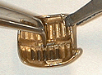

in partnership with
Factory loaded, sterilized, ready to implant plaques:
Eye Physics plaques.
2nd generation plaques (cast in 18K gold from hand carved wax prototypes).
3rd generation plaques (cast in 18K gold from wax prototypes manufactured by 3D rapid prototyping technology).
Fully customizable plaques (via rapid prototyping).
Older (e.g. COMS) style plaques.
Optional image based 3D conformal treatment consultation by the author of Plaque Simulator™.
Notes:
Eye Physics, in partnership with IsoAid, is now able to offer factory loaded, presterilized, ready to implant eye plaques. The available designs include the Eye Physics 2nd and 3rd generation plaques. 2nd generation plaques are based on the designs pioneered at USC. They are cast in 18K gold from hand carved wax prototypes. Available soon will be the Eye Physics 3rd generation plaques. These newest plaques are also cast in 18K gold from wax prototypes designed using the Plaque Simulator software and 3D rapid prototyping technology. Rapid prototyping also enables fully custom plaques to be created in a timely fashion. Of course, the older COMS style plaques are also available. Eye Physics also offers optional image based 3D conformal treatment planning consultation via the internet and express delivery services by the author of Plaque Simulator.

Slide 2
Image Based Conformal Treatment Planning for Intraocular Tumors
CT and MR imaging alone do not have the resolution required for conformal treatment of intraocular tumors.
A method for delivering conformal treatment is also required.
Notes:
The incorporation of medical imaging technologies into the treatment planning process led to a revolution in the quality of radiation therapy. External beam techniques such as 3D conformal and IMRT that greatly reduce collateral radiation damage to tissues near the target volume would not be possible without image based planning. Also, of nearly as great import to external beam therapy, is the use of patient setup lasers and cone beam CT to assure accurate delivery of these highly conformal treatments. Image based planning for conformal treatment of intraocular tumors using plaques is possible, but neither CT or MR imaging alone have the resolution required for conformal treatment of intraocular tumors, and a method for delivering conformal treatment is also required.

Slide 3
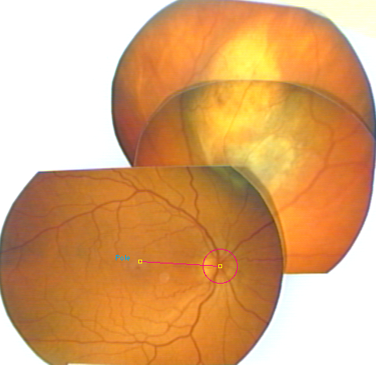
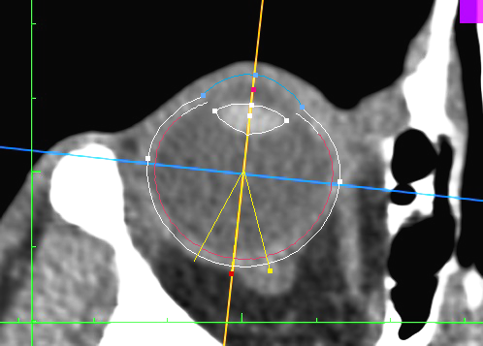
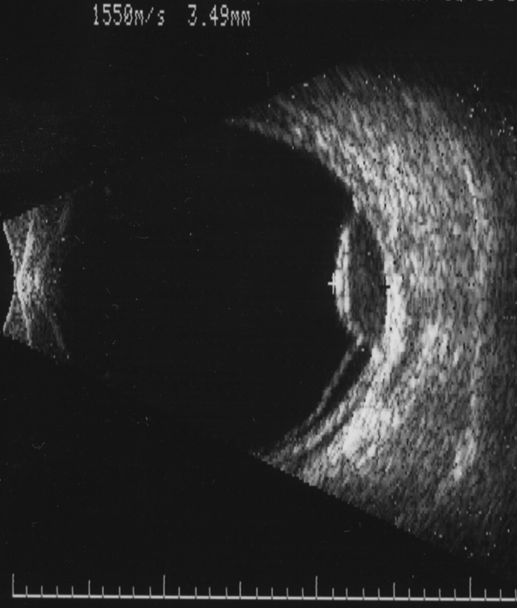
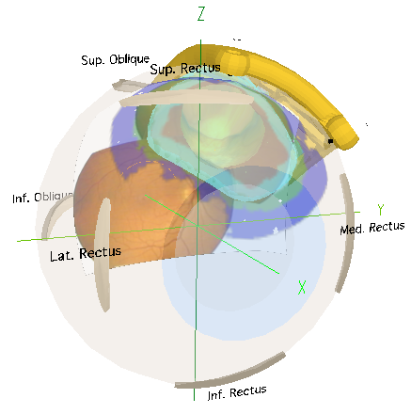
Image Based Conformal Treatment Planning for Intraocular Tumors
Conformal planning of intraocular tumors requires a 3D fusion of imaging modalities including fundus photograhy, CT (or MR), and ultrasound.
Fundus Photos CT Ultrasound 3D Model
+
+
=
Notes:
Conformal planning of intraocular tumors requires a 3D fusion of imaging modalities including fundus photograhy, CT (or MR), and ultrasound. The result is a photorealistic 3D computer model of the eye that can be combined with 3D models of the plaques and radiation sources.

Slide 4
Image Based Conformal Treatment Planning for Intraocular Tumors
Image based planning for 3D conformal treatment of intraocular tumors using eye plaques is not new.
The software component (Plaque Simulator™) was developed by Eye Physics founder Prof. Emeritus Melvin Astrahan, PhD, DABR at the University of Southern California (USC) Keck School of Medicine ca. 1990.
Plaque Simulator™ was licensed from USC for international commercial distribution in 1994.
There are many users of Plaque Simulator™ throughout the world.
Notes:
Image based planning for 3D conformal treatment of intraocular tumors using eye plaques is not new. The software component (Plaque Simulator™) was developed by Eye Physics founder, USC Emeritus Professor of Radiation Oncology, Melvin Astrahan while at the University of Southern California (USC) Keck School of Medicine ca. 1990. Plaque Simulator™ was licensed by Dr. Astrahan and USC to the BEBIG company of Germany for international commercial distribution in 1994. There are many users of the Plaque Simulator technology throughout the world.

Slide 5
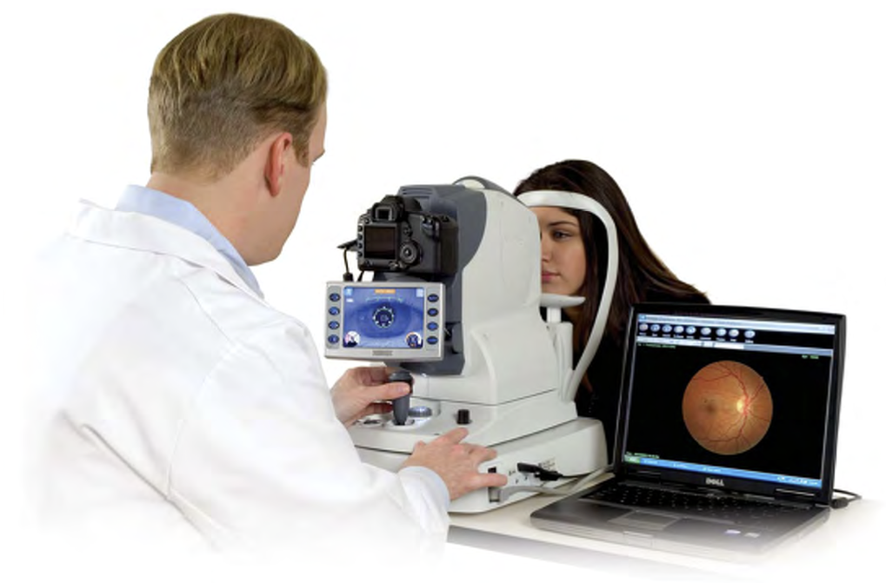
How Fundus Photography is Used
A collage of fundus photographs is used to map the tumor base and determine the location of the base with respect to easily identifiable retinal landmarks.
The fundus collage can be calibrated by finding these same landmarks in 3D CT space.
However, fundus photos do not provide the tumor height.
Fundus photos are also not possible for anterior (e.g. ciliary body) tumors.
Fundus camera photo courtesy of NIDEK Inc.
Tumor
Optic Disc
Posterior Pole
(above the fovea)
Notes:
A collage of fundus photographs of the retina is used to map the tumor base and to determine the location of the base with respect to easily identifiable retinal landmarks such as the center of the optic disc and the posterior pole of the eye which is located just above the fovea. The fundus collage can be calibrated and fused with CT imaging by finding these same landmarks in 3D CT space. The fundus photos, however, do not provide the tumor height and fundus photos are simply not possible for highly anterior locations such as tumors of the ciliary body.

Slide 6
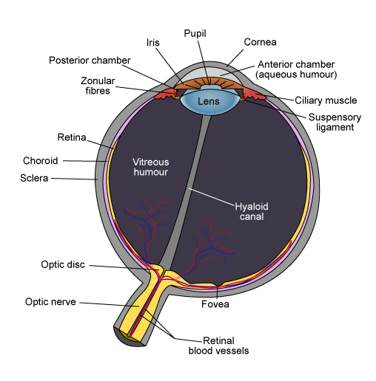
How CT and MR Images are Used
The 3D coordinates of the posterior pole on the retina and the center of the optic disc can be closely approximated from an axial CT (or MR) image which bisects the eye through the optic nerve.
CT (or MR) images also provide the location of the limbus, the equatorial diameter, and the oblate curvature of the eye.
Fundus photos can be calibrated by finding the posterior pole and optic disc in the fundus collage.
A 3D model of the fused images can be created.
limbus
posterior pole
optic disc
optic nerve
Notes:
The 3D coordinates of the posterior pole on the retina and the center of the optic disc can be closely approximated from an axial CT (or MR) image which bisects the eye through the optic nerve. CT (or MR) images also provide the location of the limbus where the sclera and cornea meet, the equatorial diameter, and the oblate curvature of the eye. Fundus photos can now be calibrated and fused with CT by finding the posterior pole and optic disc in the fundus collage. A 3D model of the fused images can now be created and displayed on a computer.

Slide 7
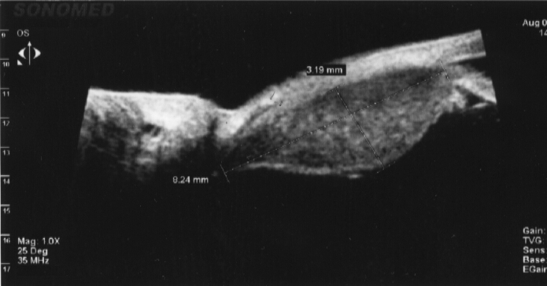
How Ultrasound Images are Used
2D ultrasound (US) images provide the best measurement of tumor height.
US images help differentiate between tumor and retinal detachment.
US is essential for anterior tumors (e.g. ciliary) that cannot be photographed.
US images, however, do not show the shape of the tumor base and are difficult to fuse with CT and fundus photos because it is difficult to find common points of reference.
Notes:
Ultrasound images are the best way to measure the height and nominal shape of the tumor mound. Ultrasound images also help to differentiate between tumor and retinal detachment, and ultrasound is essential in the planning of highly anterior tumors. Unfortunately, the ultrasound images do not show the shape of the tumor base and are difficult to fuse with CT and fundus photography because it is difficult to find common points of reference.

Slide 8
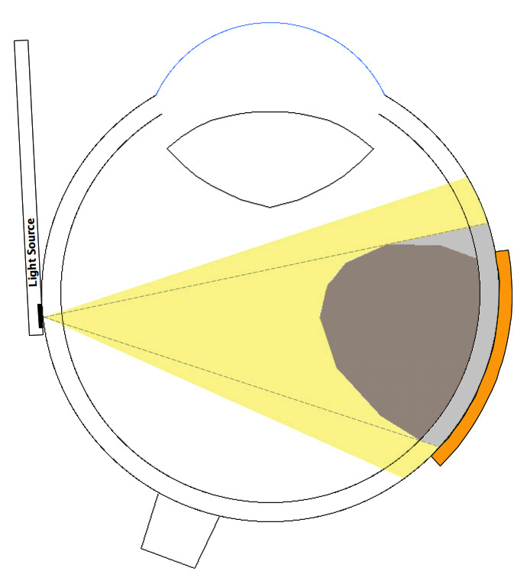
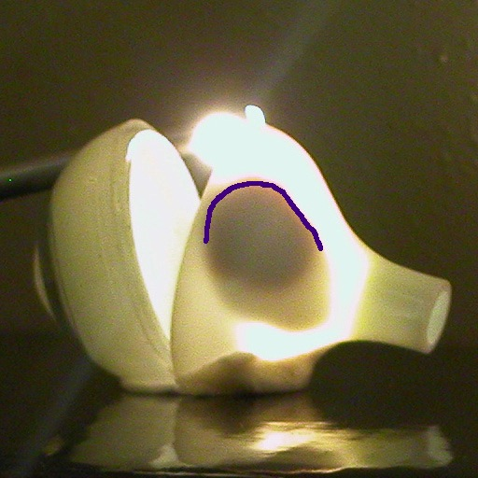
How Plaques Were Surgically Positioned
Historically, plaques have assumed simple shapes (e.g. circular perimeters) because the precise shape of the tumor base and its location within the eye were not available for advance treatment planning. These details were often not precisely determined until the time of surgery.
At surgery, the tumor base was marked by transilluminating the eye, a shadow of the tumor was cast onto the sclera, the shadow was outlined with ink, and then we hoped that the prepared circular plaque was large enough to cover the tumor base and dosimetric margin.
Nonconformal preplanning can lead to either the prescribed tumorcidal dose being delivered to a larger portion of the retina surrounding the tumor base than may be necessary to assure tumor control, or portions of the tumor receiving a less than prescribed dose if the plaque was too small.
Shadow casting can lead to plaque positioning errors depending on the position of the light source and the tumor height and location.
Suturing a small diameter plaque over a small tumor at the posterior of the eye is very difficult.
Notes:
Historically, plaques have generally assumed simple shapes, such as circular perimeters, because the shape of the tumor base and its location within the eye were not available for advance treatment planning. These details were often not available until the time of surgery wherein the tumor base was marked by transilluminating the eye, casting a shadow of the tumor onto the sclera, outlining that shadow with ink, and then hoping that the prepared circular plaque diameter was large enough to cover the tumor base and the desired dosimetric margin. This lack of conformal preplanning can lead to either the prescribed tumorcidal dose being delivered to a larger portion of the retina surrounding the tumor base than is actually necessary to assure tumor control, or to portions of the tumor receiving less than the prescribed dose if the prepared plaque happend to be a bit too small. In addition shadow casting might lead to plaque positioning errors depending on the position of the light source and the tumor height and location. Positioning errors might also result from the difficulty of accurately suturing a small plaque on the far posterior of the eye.

Slide 9
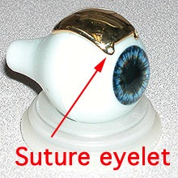
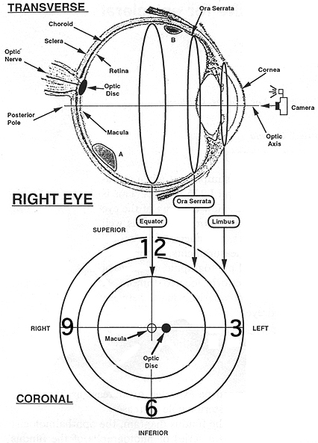
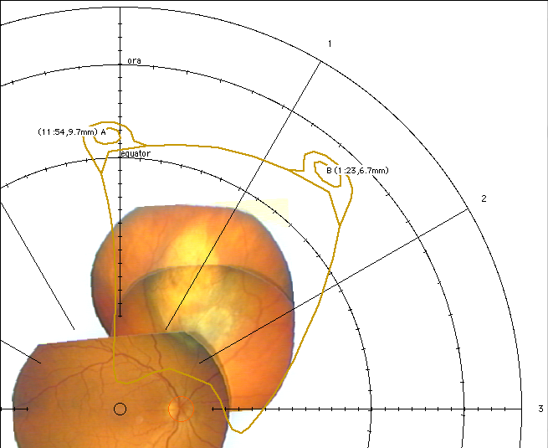
How Intraocular Tumors are Located in Plaque Simulator
The tumor is digitized by projecting the calibrated fundus collage onto the retinal diagram, a polar map of the retina.
A plaque that fits the tumor and ocular anatomy is selected.
Surgical coordinates for the plaque eyelets are calculated and expressed as clock hour and caliper distance from the limbus on the retinal diagram.
Notes:
In image based planning for eye plaques, the tumor is digitized by projecting the calibrated fundus collage onto the retinal diagram, which is a polar map of the retina. A plaque that fits the tumor, ocular anatomy, and any optimization goals is then selected. Surgical coordinates for the plaque eyelets are calculated and expressed as clock hour and caliper distance from the limbus on the retinal diagram.

Slide 10
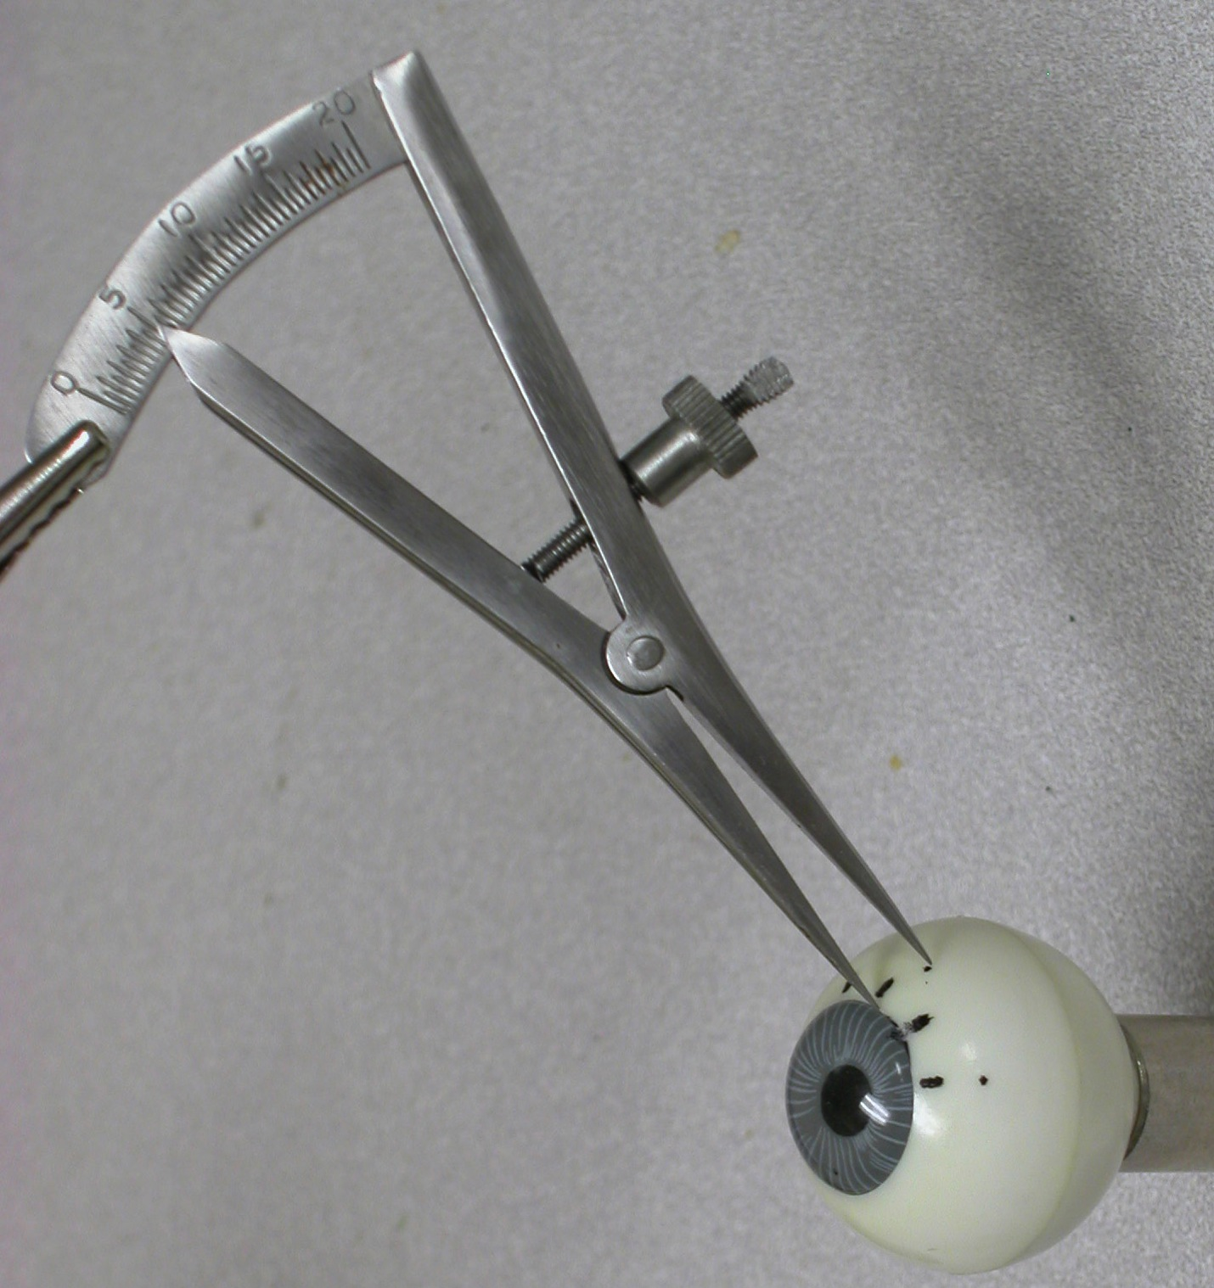
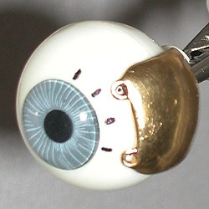
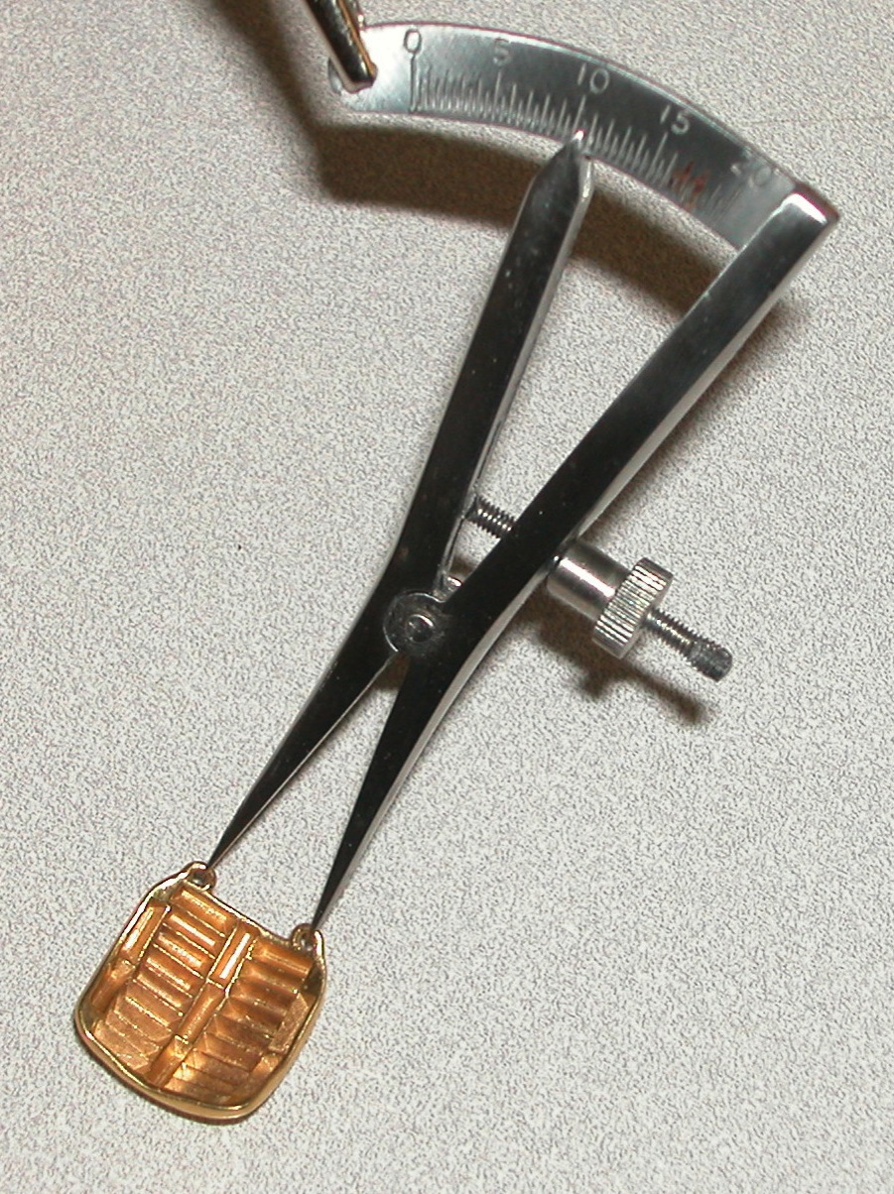
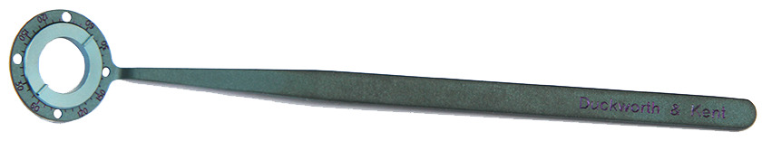
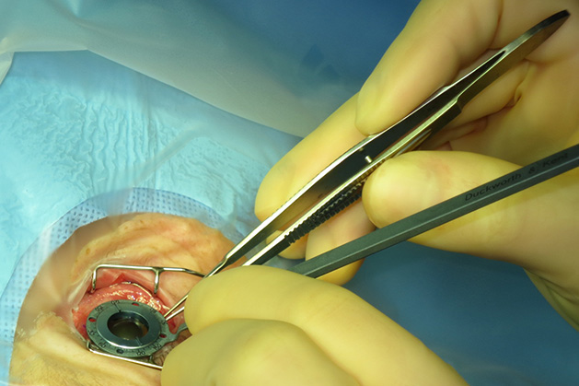
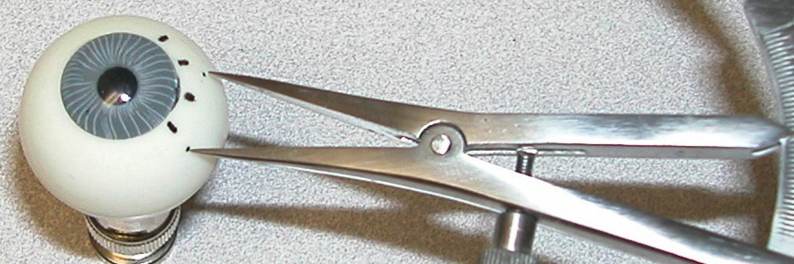
How the Plaque is Positioned Using The PS Coordinate System
The surgeon marks the meridian planes on the sclera at the limbus using a toric axis marker and then uses a Castroviejo caliper to mark the suture point on the meridian.
Placement uncertainty is about 0.5 mm so PTV margins of 2 mm surrounding the tumor base are usually sufficient.
The distance between the suture eyelets is used to cross-check the meridian spacing.
Notes:
With image based conformal planning, suture eyelet coordinates are expresed as retinal clock hour and caliper distance from the limbus and are provided to the surgeon as part of the treatment plan. The surgeon marks the coordinate clock hour meridians on the sclera at the limbus and then uses a Castroviejo caliper to approximate the clock minutes and mark the suture point. Placement uncertainty is about 0.5 mm so PTV margins of about 2 mm surrounding the tumor base are usually sufficient. The distance between the suture eyelets is used as a cross-check of the clock meridian approximations. All of the sutures are then preplaced into the sclera and then they are collectively passed through the plaque eyelets. This is usually done with an unloaded "dummy" plaque, a transparent template or a wire frame suture template in order to minimize radiation exposure to the surgeon. After the plaque coverage of the tumor has been confirmed by transillumination or indirect ophthalmoscopy, the actual radioactive plaque is substituted for the dummy or template and the sutures tied off.

Slide 11
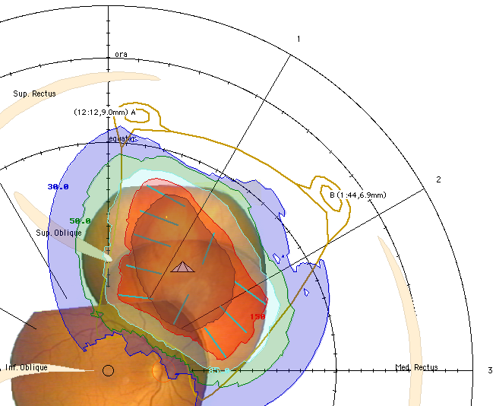
How Conformal Dosimetry is Reliably Achieved
Seed positions in the plaque are then selected to conform to the tumor base and spare the macula and optic disc as much as possible.
Conformal treatment can only be reliably delivered if the surgeon uses the PS suture eyelet coordinates (which, fortunately, they are already familiar with).
For extremely posterior tumors, the eyelets of an elliptical and/or notched plaque can be positioned on the anterior hemisphere of the eye where they are easier to suture.
Notes:
Now that we have a suture coordinate system to assure accurate delivery of conformal treatment plans, seed positions in the plaque are selected to conform to the shape of the tumor base and to exploit collimation and anisotropy to spare the macula, fovea, and optic disc as much as possible. Conformal treatment can only be reliably delivered if the surgeon uses the suture eyelet coordinates, just as IMRT can only be reliably delivered when the patient is setup correctly on the linac. The suture coordinate system allows extremely posterior and peripapillary tumors to be treated by loading seeds into only the posterior portion of an elongated plaque, or a plaque with a notch to accomodate the optic nerve, while the suture eyelets can now be safely moved to the anterior hemisphere of the eye where they are much easier to for the surgeon to work with.

Slide 12
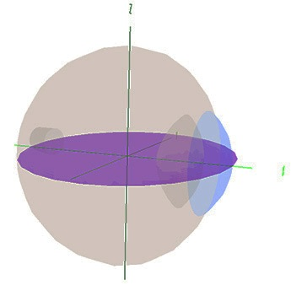
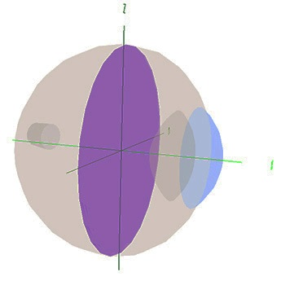
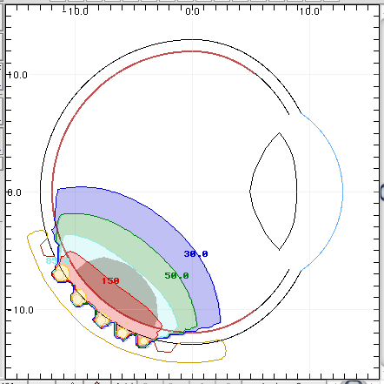
How Conformal Dosimetry is Calculated
Plaque Simulator displays radiation dose in various 2D formats such as meridian and equatorial planes, and on the retinal surface to assure tumor coverage and reduce dose to critical regions such as the macula.
3D displays are also available.
Collimation of primary radiation by the gold shell and attenuation in the Silastic™ carrier of COMS style plaques are accounted for.
Accounting for primary radiation is a good approximation because most attenuation at I-125 energies is photoelectric in nature.
Plaque Simulator uses the AAPM TG43 methodology with plaque specific enhancements derived from Monte Carlo modeling and physical measurement.
Notes:
Plaque Simulator displays radiation dose in various 3D and 2D formats such as meridian and equatorial planes, and on the retinal surface to assure tumor coverage and to reduce dose to critical regions such as the macula and optic disc. Optimization of eye plaque therapy is primarily concerned with sparing portions of the retinal surface, rather than the vitreous or even the lens which is now easily replaced with an artificial intraocular lens. Collimation of primary radiation by the gold shell, secondary flourescence, and attenuation in the Silastic™ silicone carrier of COMS style plaques are all accounted for. Ray tracing primary radiation is a good dosimetric approximation because most attenuation at I-125 energies is photoelectric in nature. Plaque Simulator uses the AAPM TG43 methodology with plaque specific enhancements that were derived from Monte Carlo modeling and physical measurement.

Slide 13
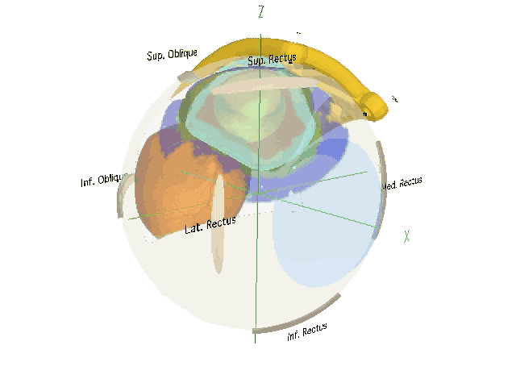
How Conformal Treatment is Simulated
The implant is simulated using 3D interactive graphics. The surgeon will know, before beginning the implant, the coordinates of every suture and which muscles may interfere with the plaque.
Tumor and PTV coverage are assured because the tumor dimensions are accurately determined in the planning process.
This saves time in the OR and prevents recurrences which might result from incorrect plaque size or uncertainty in plaque positioning.
Notes:
The implant can be simulated using 3D interactive graphics. The surgeon will know, before beginning the implant, the coordinates of every suture and which muscles may interfere with the plaque placement. Tumor and PTV coverage are assured because the tumor dimensions are accurately determined in the planning process. This saves time in the OR and prevents recurrences which might result from incorrect plaque size or uncertainty in plaque positioning.

Slide 14
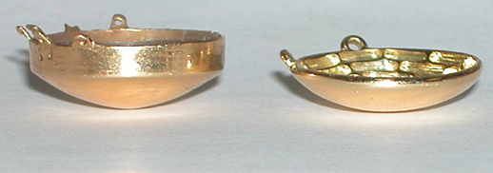
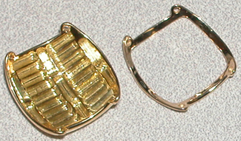
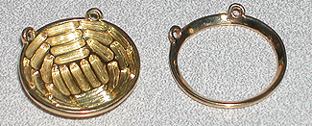
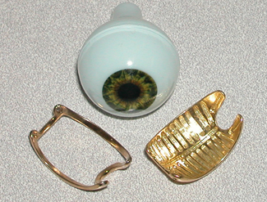
The Eye Physics Plaques
Eye Physics plaques simplify both dosimetry (no Silastic attenuation) and surgery compared to other designs.
Eye Physics plaques are thinner (<= 2mm), have larger, more rugged suture eyelets, can have deep notches to treat tumors near the optic disc, and can be flash sterilized.
The plaques and software have a 25 year history of successful clinical use at USC.
Each radiation source in an Eye Physics plaque is mounted in a collimating slot. Retina adjacent to the plaque is protected from most laterally directed primary radiation.
There is no point to vitreous fluid replacement with higher (than water) atomic number oils when Eye Physics plaques are used.
COMS Eye Physics
Notes:
Eye Physics plaques simplify both dosimetry and surgery compared to other plaque designs. Eye Physics plaques are thinner than the coresponding diameter COMS plaques, have larger, more rugged suture eyelets, and can have deep notches to treat peripapillary tumors encroaching the optic disc. Eye Physics plaques can be flash sterilized. The plaques and software have a 25 year history of successful clinical use at USC. Each radiation source in an Eye Physics plaque is mounted in its own collimating slot. Retina adjacent to the plaque is protected from most laterally directed primary radiation. There is no point to vitreous fluid replacement with higher (than water) atomic number oils when Eye Physics plaques are used.

Slide 15
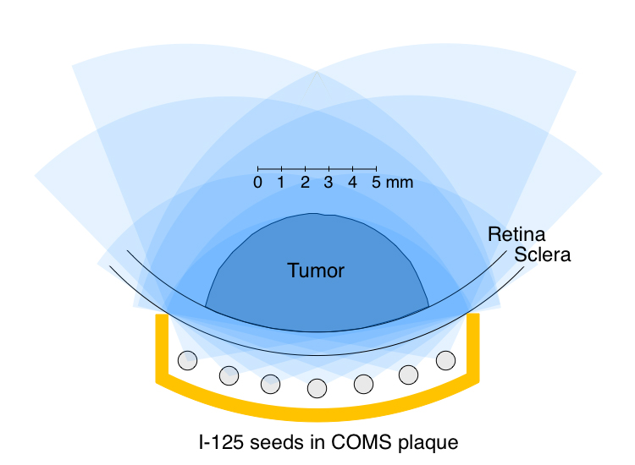
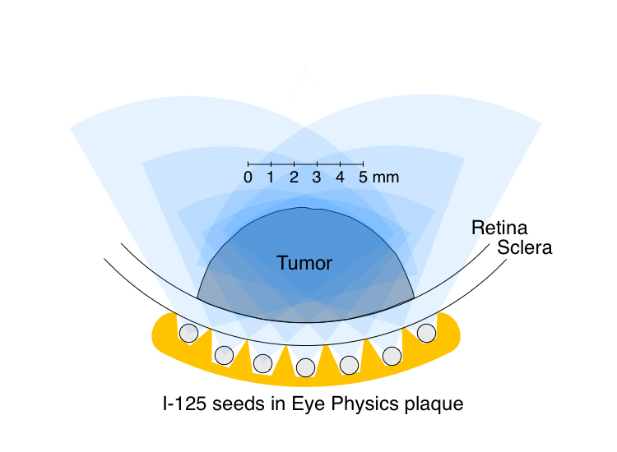
Every seed in a COMS plaque irradiates the retina and sclera under the tumor and adjacent to the plaque.
Retinal dose at the base of the tumor can be up to 10X the dose prescribed to the apex of medium to large tumors.
COMS plaque dosimetry is complicated by the atomic composition of the silicone seed carrier for low energy x-rays.
COMS plaques are thick at the edges and are designed to fit a spherical eye of one radius of curvature.
Eye Physics plaques collimate the radiation from each seed to remove lateral radiation that does not contribute to the tumor dose.
Retinal dose at the base of the tumor is usually only 2X to 3X the dose prescribed to the apex of medium to large tumors.
Eye Physics plaques are designed using Plaque Simulator technology and are manufactured using computer aided rapid prototyping technology.
Eye Physics plaques are <= 2mm thick and are available in many shapes, sizes and even mixed curvatures to perfectly fit real eyes.
Notes:
Every seed in a COMS plaque irradiates both the retina and sclera below the tumor and adjacent to the plaque edge. This occurs because the collimating lip of the COMS plaque is far from most of the seeds. Retinal dose near the base of the tumor can be up to 10X the dose prescribed to the apex of tall tumors. COMS plaque dosimetry is complicated by the atomic composition of the Silastic silicone seed carrier, COMS plaques are thick at the lip edge, and are designed to fit a perfectly spherical eye of only one diameter. In comparison, Eye Physics plaques collimate the radiation from each seed to remove laterally directed primary radiation that does not contribute to the tumor dose. As a result, retinal dose at the base of the tumor is only 2X to 3X the dose prescribed to the apex for tall tumors. The newest 3rd generation Eye Physics plaques were designed using Plaque Simulator and are manufactured using rapid prototyping computer files in .STL and .DXF format exported from Plaque Simulator. This assures a 1/10,000 inch correspondence between the computer models and the plaques. The depth of the collimating slots varies in 3rd generation plaques, being slightly shallower at the periphery of the plaque in order to maintain dose uniformity to the edge of the plaque, much in the manner of the Patterson-Parker System for brachytherapy, all without having to resort to seeds of higher activity. Eye Physics plaques are <= 2mm thick and are available for eyes with diameters between 22 and 26 mm. There are many shapes and sizes, and oblate and mixed curvatures will be available to perfectly fit a wide variety of aspherical eyes.

Slide 16
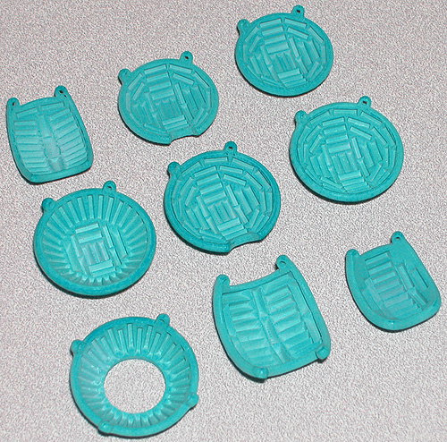
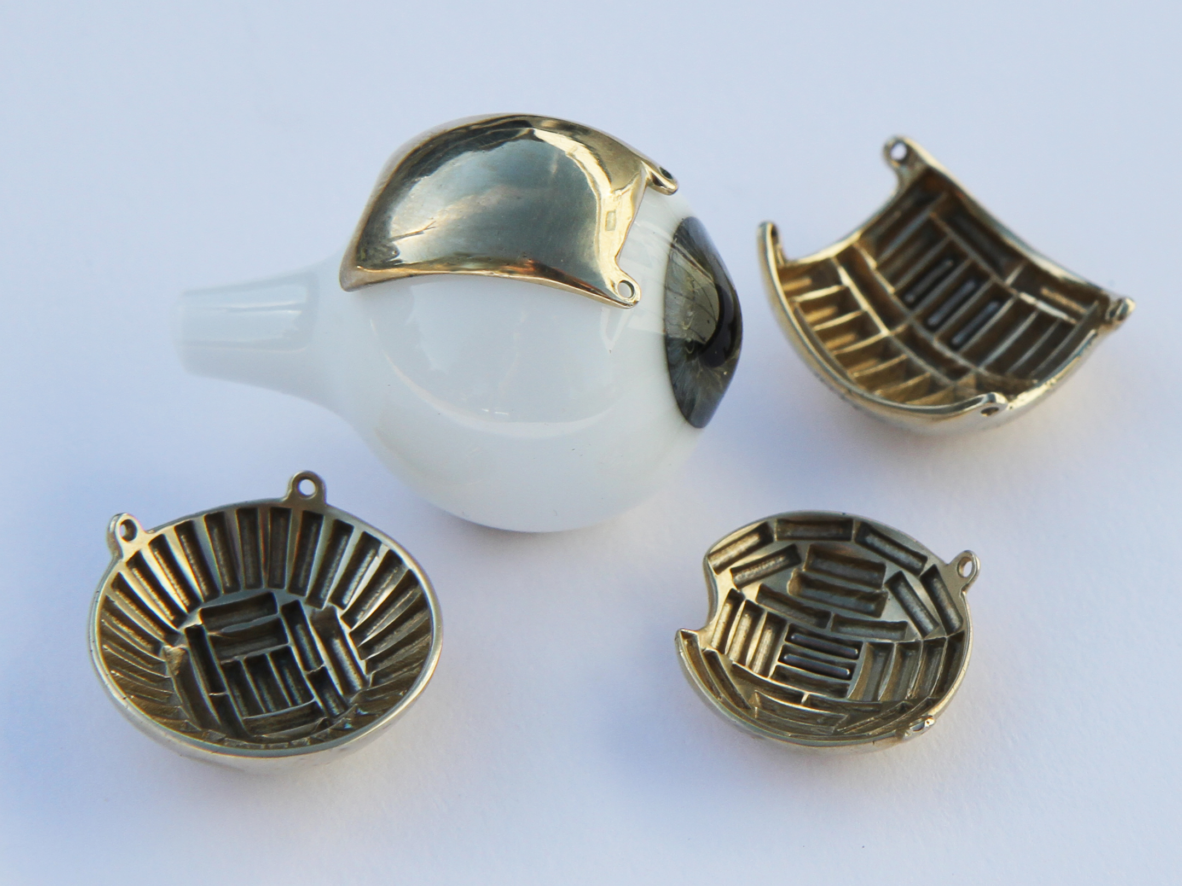
These wax prototypes were designed using Plaque Simulator software and manufactured using 3D rapid prototyping technology to precisely match the Plaque Simulator models.
The wax prototypes are then cast in gold to make the final product.
Eye Physics 3rd generation computer designed and prototyped plaques will soon be available in dozens of preconfigured as well as fully customizable sizes, shapes, curvatures and source arrangements. Our plaques are <= 2 mm thick and the radionuclide sources are individually collimated to create a dose distribution which conforms to the tumor, spares the surrounding retina, and provides a near perfect mechanical fit to each patient's eye.
Notes:
The blue-green plaques pictured above are a few of the computer prototyped wax models for Eye Physics 3rd generation plaques that will soon be available in dozens of preconfigured as well as fully customizable sizes, shapes, curvatures and source arrangements. These wax prototypes are cast in 18K gold to make the final product. The plaques are <=2 mm thick and the radionuclide sources are individually collimated in slots of varying depth and solid angle of irradiation in order to create a dose distribution which conforms to the tumor, spares the surrounding retina, and provides a near perfect mechanical fit to each patient's eye.

Slide 17
Luxton G, Astrahan MA and Petrovich Z. Measurements of backscatter from a single seed of I-125 for eye plaque dosimetry. Medical Physics 15:397-400, 1988.
Luxton G, Astrahan MA, Liggett P, Neblett DL, Cohen DM and Petrovich Z. Dosimetric calculations and measurements of gold plaque ophthalmic irradiators using Iridium-192 and Iodine-125 seeds. International Journal of Radiation Oncology, Biology, Physics 15:167-176, 1988.
Astrahan M, Luxton G, Jozsef G, Kampp TD, Liggett P and Sapozink MD. An interactive treatment planning system for ophthalmic plaque radiotherapy. International Journal of Radiation Oncology, Biology, Physics 18:679-687, 1990.
Luxton G, Astrahan M, Findley D and Petrovich Z. Measurement of dose rate from exposure-calibrated I-125 seeds. International Journal of Radiation Oncology, Biology, Physics 18:1199-1207, 1990.
Lean EK, Cohen D, Liggett P, Luxton G, Hyden E, Green R, Astrahan MA and Petrovich Z. Episcleral radioactive plaque therapy: initial clinical experience with 56 patients. Amer. J. Clin. Oncology 13:185-190,1990.
Petrovich Z, Liggett PE, Luxton G, Lean E, Langholz B and Astrahan MA. Radioactive plaque therapy in the management of primary malignant ocular melanoma: An overview. Endocurietherapy, Hyperthermia Oncology, 6: 131-141, 1990.
Astrahan M, Luxton G, Jozsef G, Liggett P and Petrovich Z. Optimization of I-125 ophthalmic plaque brachytherapy. Medical Physics 17:1053-1057, 1990.
Liggett PE, Ma C, Astrahan MA, Pince KJ, Green R, McDonnell J and Petrovich Z. Combined localized current field hyperthermia and irradiation for intraocular tumors. Ophthalmol 98:1830-1836, 1991.
Petrovich Z, Astrahan M, Luxton G, Green R, Langholz B and Liggett P. Episcleral plaque thermoradiotherapy in patients with choroidal melanoma. International Journal of Radiation Oncology, Biology, Physics 23:599-603, 1992.
Petrovich Z, Luxton G, Langholz B, Astrahan MA and Liggett PE. Episcleral plaque radiotherapy in the treatment of uveal melanomas. Int J Radiat Oncol Biol Phys 24:247-251, 1992.
Evans MDC, Astrahan MA, and Bate R. Tumor localization using fundus view photography for episcleral plaque therapy. Medical Physics 20:769-775, 1993.
Petrovich Z, Pike M, Astrahan MA, Luxton G, Murphree AL and Liggett PE. Episcleral plaque thermoradiotherapy. Am J Clin Oncol 19:207-211, 1996.
Astrahan MA, Luxton G, Pu Q and Petrovich Z. Conformal Episcleral Plaque Therapy. International Journal of Radiation Oncology, Biology, Physics 39:505-519, 1997.
Astrahan M. A patch source model for treatment planning of ruthenium ophthalmic applicators. Medical Physics 30(6):1219-1228, 2003.
Astrahan M. Improved treatment planning for COMS eye plaques, International Journal of Radiation Oncology, Biology, Physics, 61(4):1227-1242, 2005.
Astrahan M, Szechter A and Finger P. Design and Dosimetric Considerations of a Modified COMS Plaque: The reusable seed-guide insert. Medical Physics 32(8), 2706-2716, 2005.
Notes:
Some of DR. Astrahan's eye plaque publications

